Slide 1


Outlier Detection
Power BI Visuals - Description

Slide 2


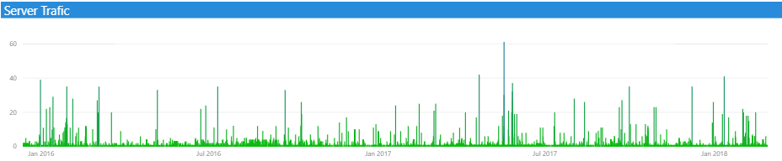
Server Traffic Analysis
Total number of requests reached to server
Average number of requests reached to sever. Request density per minute.
Total number of unique IP addresses made request to server
Number of bytes transferred from server per second
Number of bytes transferred from server per second
Pattern of number of request reached to server. Spikes denotes number of requests.

Slide 3
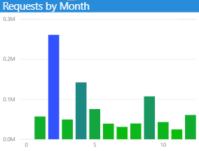
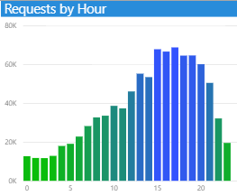
Server Traffic Analysis
“This information can help in scaling web servers as per request density.
Server administrator can scale down when server remains less busy in a day.”
This chart denotes number of requests reached to server by months.
This chart tells more number of requests reached to server in month February, then in April month.
This chart denotes number of requests reached to server by hours of day.
Blue bars denote more number of requests. This bar chart denotes between 14 and 20 hours of day more number of requests reached to server. Means server remained busy between these two hours.

Slide 4
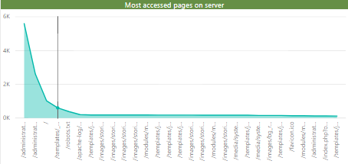
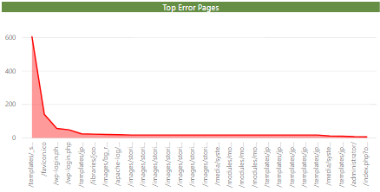
Endpoint Analysis
This chart denotes which pages or links accessed most. This information helps to understand access behavior.
This chart denotes which pages or links had errors or issues when accessed.

Slide 5
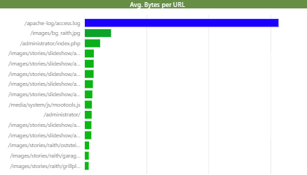
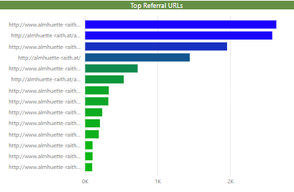
Endpoint Analysis
This chart denotes top urls along with which more bytes transferred when accessed.
This chart denotes top referral urls.

Slide 6
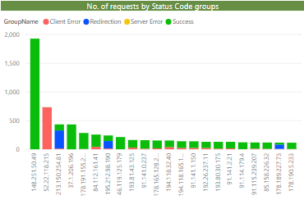
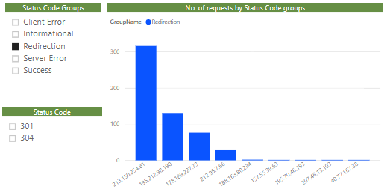
Status Code Analysis
This chart can be filtered using slicer visuals to make further deep analysis.
If we select Redirection Status Code group it shows the list of top IPs which exhibited more Redirection errors.
This chart denotes count of requests from IPs divided by Status Code groups. This chart helps to identify the outlier IPS from where more requests of non-success status code group is coming.
In above chart only client errors received from IP 52.22.118.215 (Marked in red bar). Around 700 requests having 404 errors, this IP seems showing suspicious activities.

Slide 7
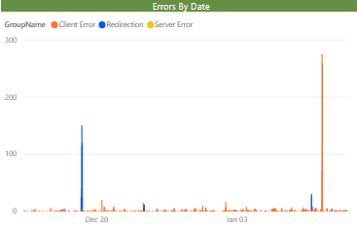
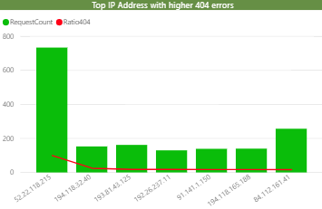
Status Code Analysis
This chart displays patterns of requests by non-success status code groups.
This chart helps to identify IPs which shows large ratio of requests count with 404 errors vs requests count with success status code. In above chart IP 52.22.118.215 depicts 99 ratio.

Slide 8

  THANKS!
Corporate Site - ThirdEyeData.io
Eyera - IoT Solution - Eyera.io
Safera - Crime Analytics & Predictions - Safera.us
Syra - Custom Bot for Enterprises - Syra.ai
Big Data Cloud Community - BigDataCloud.com, meetup.com/BigDataCloud
Phone - (408) 462-5257
Email - answers@thirdeyedata.io
Twitter - @thirdeye_data
LinkedIn - linkedin.com/company/ThirdEyeData
Facebook - facebook.com/ThirdEyeData
YouTube - youtube.com/user/ThirdEyeCSS
Vimeo - vimeo.com/channels/ThirdEyeData

